Slide 1
Lecture 8. Sorting (2)
Instructor: 黄群
huangqun@pku.edu.cn
School of EECS
Peking University

Slide 2
Bucket Sort & Radix Sort
Previously, comparison-based algorithms
Insertion sort, Bubble sort, Selection sort, …
Shellsort, …
Heapsort, Mergesort, Quicksort, …
If the distribution of the sort keys has suitable properties, …
Bucket sort
Radix sort
…

Slide 3
Outline
Bucket sort (桶式排序)
Radix sort (基数排序)

Slide 4
Bucket Sort
Assumption
input sequence with n data
the sort keys are in the range {0, 1, …, m-1}
Basic idea:
1. Create m buckets, each of which corresponds to one possible value of sorted keys
2. Add each input data to an appropriate bucket
3. Concatenate the data in the buckets
Expected total time is O(n + m)
if m is O(n) → sorting algorithm in O(n) !

Slide 5
Bucket Sort
2
2
1
1
3
3
1
1
2
2
B1
B2
B3
1
2
1
2
3
1
1
2
2
3

Slide 6
Questions
How to represent buckets?
How to concatenate buckets?

Slide 7
Method 1: Linked List
Each element is put in one of the m “buckets”

Slide 8
Method 1: Linked List
Now, pull the elements from the buckets into the array
At last, the sorted array
(sorted in a stable way):

Slide 9
Method 2: Array of Counters
buckets of linked lists ⇒ buckets of counters
Each counter records number of elements in a bucket
How to concatenate?
Given an element e in the input sequence
If we can count the number of preceding elements (denoted by i) of e, …
We will have A[i] = e in the sorted array
Let’s see how we can compute the number i …

Slide 10
Example
7
3
8
9
6
1
8’
1’
2
Input:
First pass
(counting)
Second pass
(indexing)
0 1 2 3 4 5 6 7 8 9
0
2
1
1
0
0
1
1
2
1
＋
＋
＋
＋
count[i]=count[i-1]+count [i];
0
2
3
4
4
4
5
6
8
9
0 1 2 3 4 5 6 7 8 9
Notes:
10
//统计每个取值出现的次数
for (i=0;i<n;i++)
count[Array[i]]++;
//统计小于等于i的元素个数
for (i=1;i<max;i++)
count[i]=count[i-1]+count [i];
//按顺序输出有序序列
for (i=n-1;i>=0;i--)
Array[--count[TempArray[i]]] = TempArray[i];

Slide 11
Example
7
3
8
9
6
1
8’
1’
2
Input:
First pass(counting)
Second pass (indexing)
Final Results：
0 1 2 3 4 5 6 7 8 9
0
2
1
1
0
0
1
1
2
1
5
6
0
2
2
4
4
4
6
7
3
5
8
9
0
4
8
1
3
0 1 2 3 4 5 6 7 8
1
1’
2
3
6
7
8
8’
9

Slide 12
Sample Code (Method 2)
template <class Record> void BucketSort(Record Array[], int n, int max) {
Record *TempArray = new Record[n]; // temp array
int *count = new int[max]; // Count array
int i;
for (i = 0; i < n; i++) // Copy to temp array
TempArray[i] = Array[i];
for (i = 0; i < max; i++) // Initialize counters
count[i] = 0;
for (i = 0; i < n; i++) // 1st pass: count occurences
count[Array[i]]++;
for (i = 1; i < max; i++) // 2nd pass: count # of preceding elements
count[i] = count[i-1]+count [i];
for (i = n-1; i >= 0; i--) // Scan from tail to keep stability
Array[--count[TempArray[i]]] = TempArray[i];
}
Notes:
12

Slide 13
Analysis
n: length of the input sequence
m: range of the input integers in [0,m)
Time complexity
Θ(n)+ Θ(m) time to count
Θ(n) time to generate the sorted array
Overall Θ(n+m)
(suitable when m is relatively smaller than n)
Space complexity
counter of size m
temporary array of size n
Overall Θ(n+m)

Slide 14
Outline
Bucket sort (桶式排序)
Radix sort (基数排序)

Slide 15
Radix Sort
Motivation:
Bucket sort is only suitable for the cases when m (the number of possible values) is relatively smaller than n (the number of elements to sort)
Radix Sort
When m is very large, we can decompose sorted keys into multiple fields

Slide 16
Formal Formulation
A list with n elements
R = { r₀，r₁，…，r_{n-1} }
Sorted key K is composed of d sub-keys
K = ( k_{d-1}，k_{d-2}，…，k₁，k₀ )

Slide 17
A Simple Example: Playing Card Ordering
Suit
Spade ♠ > Heart ♥ > Diamond ♦ > Club ♣
Rank
A > K > Q > J > 10 > … > 2
Input
♠3 ♥J ♣8 ♥9 ♠9 ♦3 ♣A ♦7
Output
A sorted sequence in a non-decreasing order
Primary ordered by suit
Secondary ordered by rank
Notes:
17

Slide 18
♠3 ♥J ♣8 ♥9 ♠9 ♦3 ♣A ♦7
Most Significant Digit first (MSD)
Sort by suite: ♣8 ♣A ♦3 ♦7 ♥J ♥9 ♠3 ♠9
Sort by rank: ♣8 ♣A ♦3 ♦7 ♥9 ♥J ♠3 ♠9
Least Significant Digit first (LSD)
Sort by rank: ♠3 ♦3 ♦7 ♣8 ♥9 ♠9 ♥J ♣A
Sort by suit: ♣8 ♣A ♦3 ♦7 ♥9 ♥J ♠3 ♠9
stability required!
Notes:
18

Slide 19
Most Significant Digit First (MSD)
Sort from k_{d-1} to k₀
Start with k_{d-1}, partition elements into several buckets
Repeatedly partition each bucket into smaller buckets based on k_{d-1,} k_{d-2, …} k₀
Merge all buckets
Pros
Intuitive for human beings
Cons
A large number of buckets generated

Slide 20
Least Significant Digit First (LSD)
Sort from k₀ to k_{d-1}
Sort based on k₀
For the sorted results, sort based on k₁
Repeated sort based on k_{2…} k_{d-1}
Pros
Easy for computers
Cons
Need a stable sort (Why?)

Slide 21
Correctness of LSD with Stable Sort
Proof by induction:
It is correct for single digit
Assume lower-order digits {j: j<i} are sorted
Show that sorting next digit i leaves array correctly sorted
If two digits at position i are different, ordering numbers by that digit is correct (lower-order digits irrelevant)
If they are the same, numbers are already sorted on the lower-order digits. Since we use a stable sort, the numbers stay in the right order

Slide 22
Implementation
Use Bucket Sort as the stable sorting algorithm
Based on sequential list (array)
Based on linked list
Assume
n elements
radix r (usually 10)
number of digits d

Slide 23
Radix Sort with Array
initial sequence
1st count
2nd count
gather
First, sort the LSD

Slide 24
Radix Sort with Array
1st count
2nd count
gather
final sequence
Then, sort the MSD

Slide 25
Radix Sort with Array: Sample Code
template <class Record>
void RadixSort(Record Array[], int n, int d, int r) {
Record *TempArray = new Record[n];
int *count = new int[r]; int i, j, k;
int Radix = 1;
for (i = 1; i <= d; i++) {
for (j = 0; j < r; j++)
count[j] = 0;
for (j = 0; j < n; j++) {
k = (Array[j] / Radix) % r; // take the i-th least significant digit
count[k]++; // count the elements with digit k
}
for (j = 1; j < r; j++) // Accumulate
count[j] = count[j-1] + count[j];
for (j = n-1; j >= 0; j--) { // Scan from tail
k = (Array[j] / Radix ) % r; // take the i-th least significant digit
TempArray[--count[k]] = Array[j]; // put to the tmp array
}
for (j = 0; j < n; j++)
Array[j] = TempArray[j];
Radix *= r;
}
}

Slide 26
Analysis of Radix Sort with Array
Space cost
size n for the temporary array
size r for the counter array
Overall: O(n+r)
Time cost
Each bucket sort in O(n+r)
d times of bucket sorts
Overall O(d(n+r))

Slide 27
Radix Sort with Linked Lists
Scatter and count the data with an array of linked lists
No temporary array needed

Slide 28
97
53
88
59
26
41
88’
31
22
41
31
22
53
26
(b) 1st scatter
97
88
88’
59
41
31
22
53
26
97
88
88’
59
(c) 1st gather
Notes:
28

Slide 29
41
31
22
53
26
97
88
88’
59
22
26
31
41
53
59
88
88’
97
(d) 2nd scatter
(e) 2nd gather
(final)
22
26
31
41
53
59
88
88’
97
Notes:
29

Slide 30
Sample Code
// All elements also form a linked list
class Node {
public:
Record key; // Sorted Key
int next; // Index of next node, as pointer
};
// All buckets as array of linked list
class StaticQueue {
public:
int head; // index of first element, init: -1
int tail; // index of last element, init: -1
};

Slide 31
Sample Code
void RadixSort(Node *Array, int n, int d, int r) {
int i, first = 0; // first points to the first element
StaticQueue *queue = new StaticQueue[r];
for (i = 0; i < n-1; i++)
Array[i].next = i + 1; // Init
for (i = 0; i < d; i++) { // sort for each digit
Distribute(Array, first, i, r, queue);
Collect(Array, first, r, queue);
}
delete[] queue;
// Output
}

Slide 32
Sample
void Distribute(Node *Array, int first, int i, int r, StaticQueue *queue) {
int j, k, a, curr = first;
for (j = 0; j < r; j++) queue[j].head = -1;
while (curr != -1) { // Travel all elements
k = Array[curr].key;
for (a = 0; a < i; a++)
k = k / r;
k = k % r; // Get the i-th digit
if (queue[k].head == -1) // Insert into linked list
queue[k].head = curr;
else
Array[queue[k].tail].next = curr;
queue[k].tail = curr;
curr = Array[curr].next; // Move to next element
}
}

Slide 33
Sample Code
void Collect(Node *Array, int& first, int r, StaticQueue *queue) {
int last, k=0; // last means the last gathered element
while (queue[k].head == -1) k++; // Find the first non-empty bucket list
first = queue[k].head; last = queue[k].tail;
while (k < r-1) {
k++;
while (k < r-1 && queue[k].head == -1) // Next non-empty bucket list
k++;
if (queue[k].head != -1) {
Array[last].next = queue[k].head;
last = queue[k].tail; // Gather all elements in this bucket
}
}
Array[last].next = -1;
}

Slide 34
Analysis of Radix Sort with Linked Lists
Space cost
n records
r header pointers in the queue
Overall O(n+r)
Time cost
O(d(n+r))

Slide 35
Notes
d >= log_{r}n
Problem: sort 1 million 64-bit numbers
Treat as four-digit radix 2¹⁶ numbers (r=2¹⁶)
Can sort in just four passes with radix sort!
Running time: 4 * ( 1 million * 2 + 2¹⁶ ) ≈ 8 million operations
Compare with typical O(n log n) comparison sort
Requires approx lg n = 20 operations per number being sorted
Total running time ≈ 20 million operations
Important to select a proper r

Slide 36
Notes
In general, radix sort based on bucket sort is
Asymptotically fast (i.e., O(n))
Simple to code
A good choice
Can radix sort be used on real numbers?

Slide 37
Does it Work for Real Numbers?
What if keys are not integers?
Assumption: input is n reals from [0, 1)
Basic idea:
Create N buckets to divide interval [0,1) into subintervals of size 1/N
Add each input element to appropriate bucket and sort buckets with insertion sort
Uniform input distribution → O(1) bucket size
Therefore the expected total time is O(n)

Slide 38
Does it Work for Real Numbers?
Partitioning keys in buckets is similar with …. ?
Quicksort
Create 2 buckets to divide the keys
Add each input to appropriate bucket and sort buckets with (recursive) quicksort
“Binary quicksort”: radix sort with radix=2

Slide 39
Summary
Bucket sort
Radix sort:
Assumption: input has d digits ranging from 0 to r
Basic idea:
Sort elements by digit starting with least significant
Use a stable sort (like bucket sort) for each stage
Each pass over n numbers with 1 digit takes time O(n+r), so total time O(d(n+r))
When d is constant and r=O(n), takes O(n) time
Fast, Stable, Simple

Slide 40
History of Radix Sort
Dr. Herman Hollerith’s sorting machines
1890 Census Equipment: tabulator + sorter
“The first wholly successful information processing system to replace pen and paper.”
“These machines reduced a ten-year job to three months.”
1911: Hollerith’s company merged with several others to form the Computing-Tabulating-Recording Company (CTR)
1924: CTR changed its name to International Business Machines Corporation
This is how IBM got rich originally!
http://www.columbia.edu/cu/computinghistory/hollerith.html

Slide 41
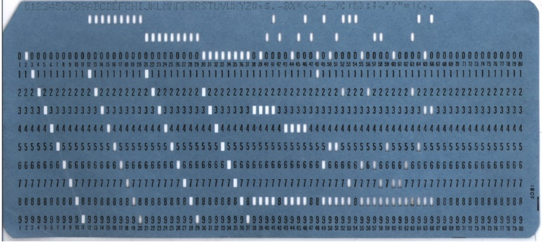
Radix Sort: Punched Card
http://en.wikipedia.org/wiki/Punched_card

Slide 42
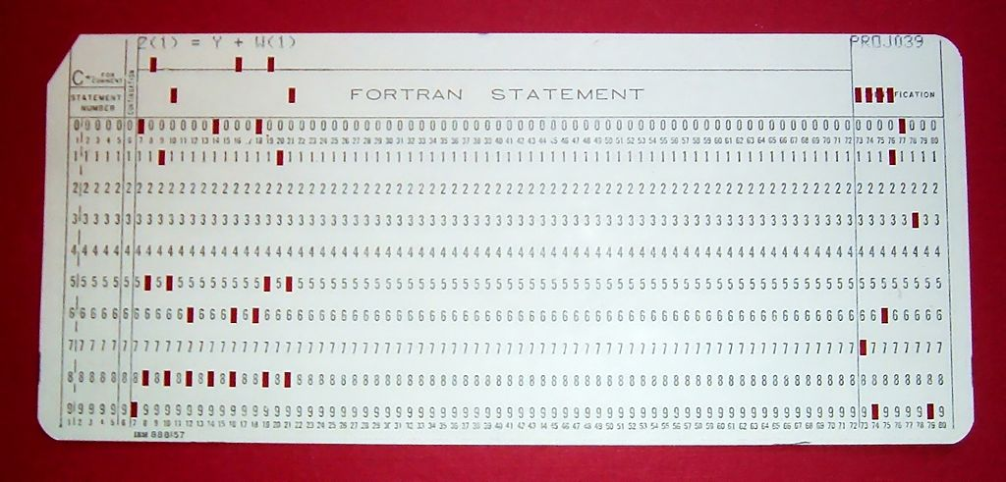
Radix Sort: Punched Card
http://en.wikipedia.org/wiki/Punched_card

Slide 43
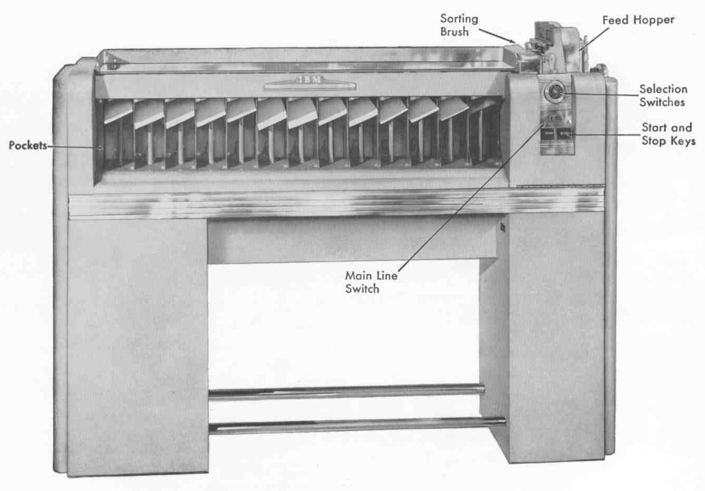
Radix Sort: IBM 082 (1949, 650 cpm)
http://www.columbia.edu/cu/computinghistory/sorter.html
Notes:
play a video of a working IBM 082

